Slide 1
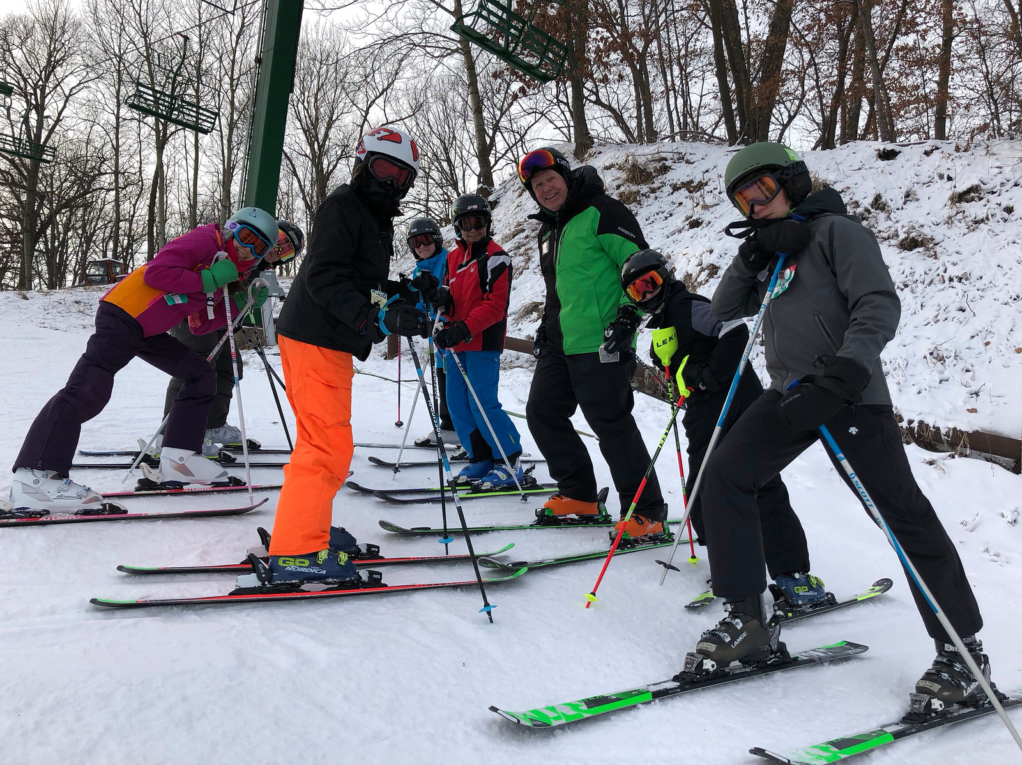
Blizzard Ski MN Exploratory Research
Zach Lulavy

Slide 2
Comparative analysis

Slide 3
Users/personas
Management
Staff
Members/parents
Needs more efficient portal for better access to useful information
Makes RSVPs and wants higher
Needs more efficient means to responding to RSVPs from management

Slide 4
RSVPs

Slide 5
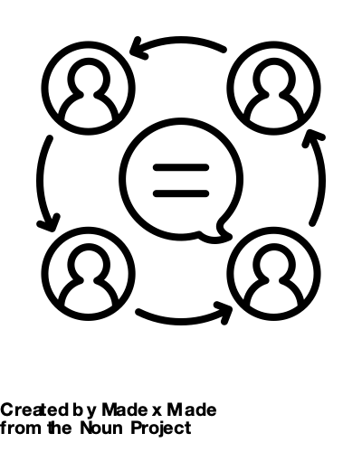
RSVPs
Blizzard uses an RSVP system to account for how many staff and how many members will show up to their weekly events. After stakeholder interview, bus routes become the biggest area of concern for having RSVPs responded to on time. No show fees
RSVPs are unique to Blizzard because their program doesn’t require payment in full and their bus routes are flexible and new bus stops are made weekly based on RSVP responses
Stats of current RSVP responses
Exploratory Methods:
Cognitive walkthrough
Comparative analysis

Slide 6
2019/20 stats thus far
9% total no response rate
7% staff no response rate
10% members no response rate
Count of Response | Column Labels
Row Labels | No | No Reply | Yes | Grand Total
Member | 93 | 65 | 497 | 655
Staff | 35 | 12 | 115 | 162
Grand Total | 128 | 77 | 612 | 817
Count of Response | Column Labels
Row Labels | No | No Reply | Yes | Grand Total
Member | 82 | 62 | 509 | 653
Staff | 31 | 10 | 112 | 153
Grand Total | 113 | 72 | 621 | 806
Trip 1 is an outlier, and is not
statistically significant in this case
Trip 2
Trip 3

Slide 7
Cognitive Walkthrough
Key user Tasks:
Open email
Click RSVP link
Record response (yes or no)
Select mode of transport
Submit RSVP
Findings:
Users aren’t having issues responding, but getting them to open the email and click the link.
How can I make link more obvious

Slide 8
Receiving RSVP
Issues:
Clarity
Redundancy
Recommendations:
Focus on microcopy
Change subject
Change preview field

Slide 9
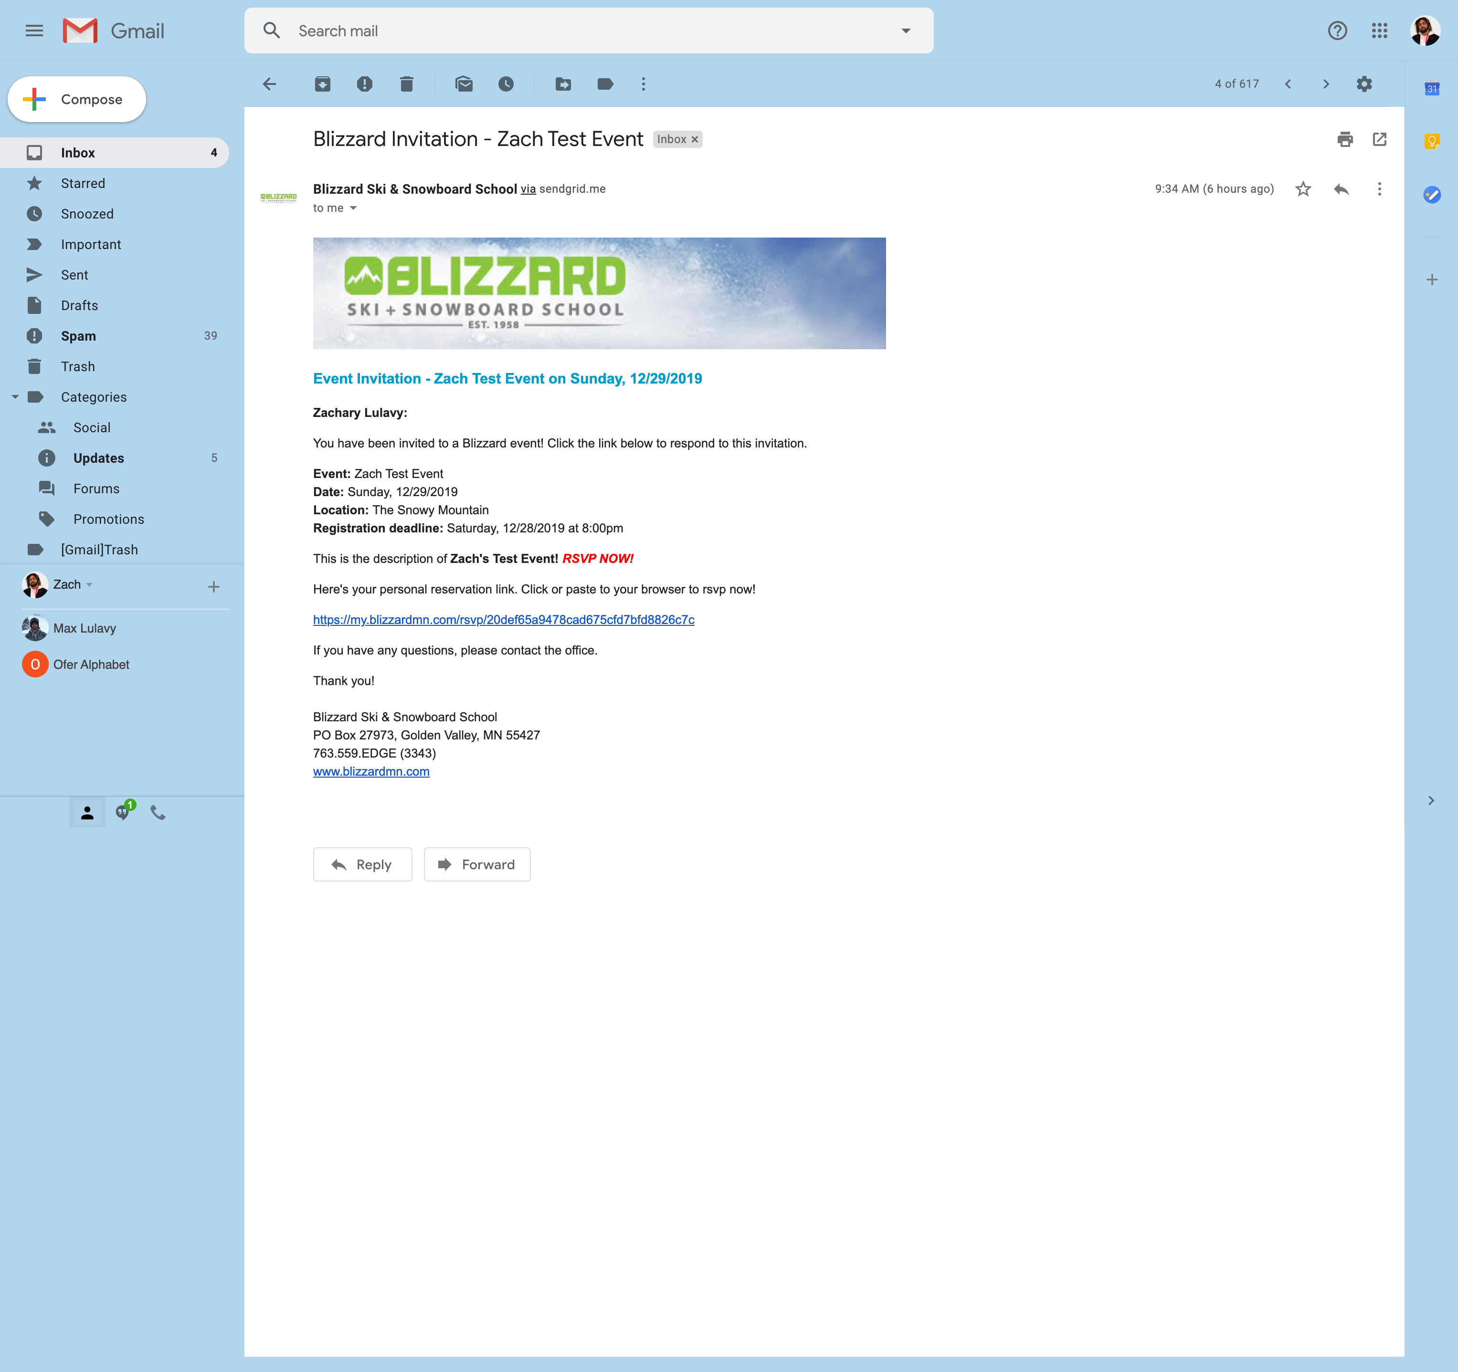
Opening RSVP request
Issues:
Hierarchy
Clarity
Recommendations:
Move Link higher
Less text

Slide 10
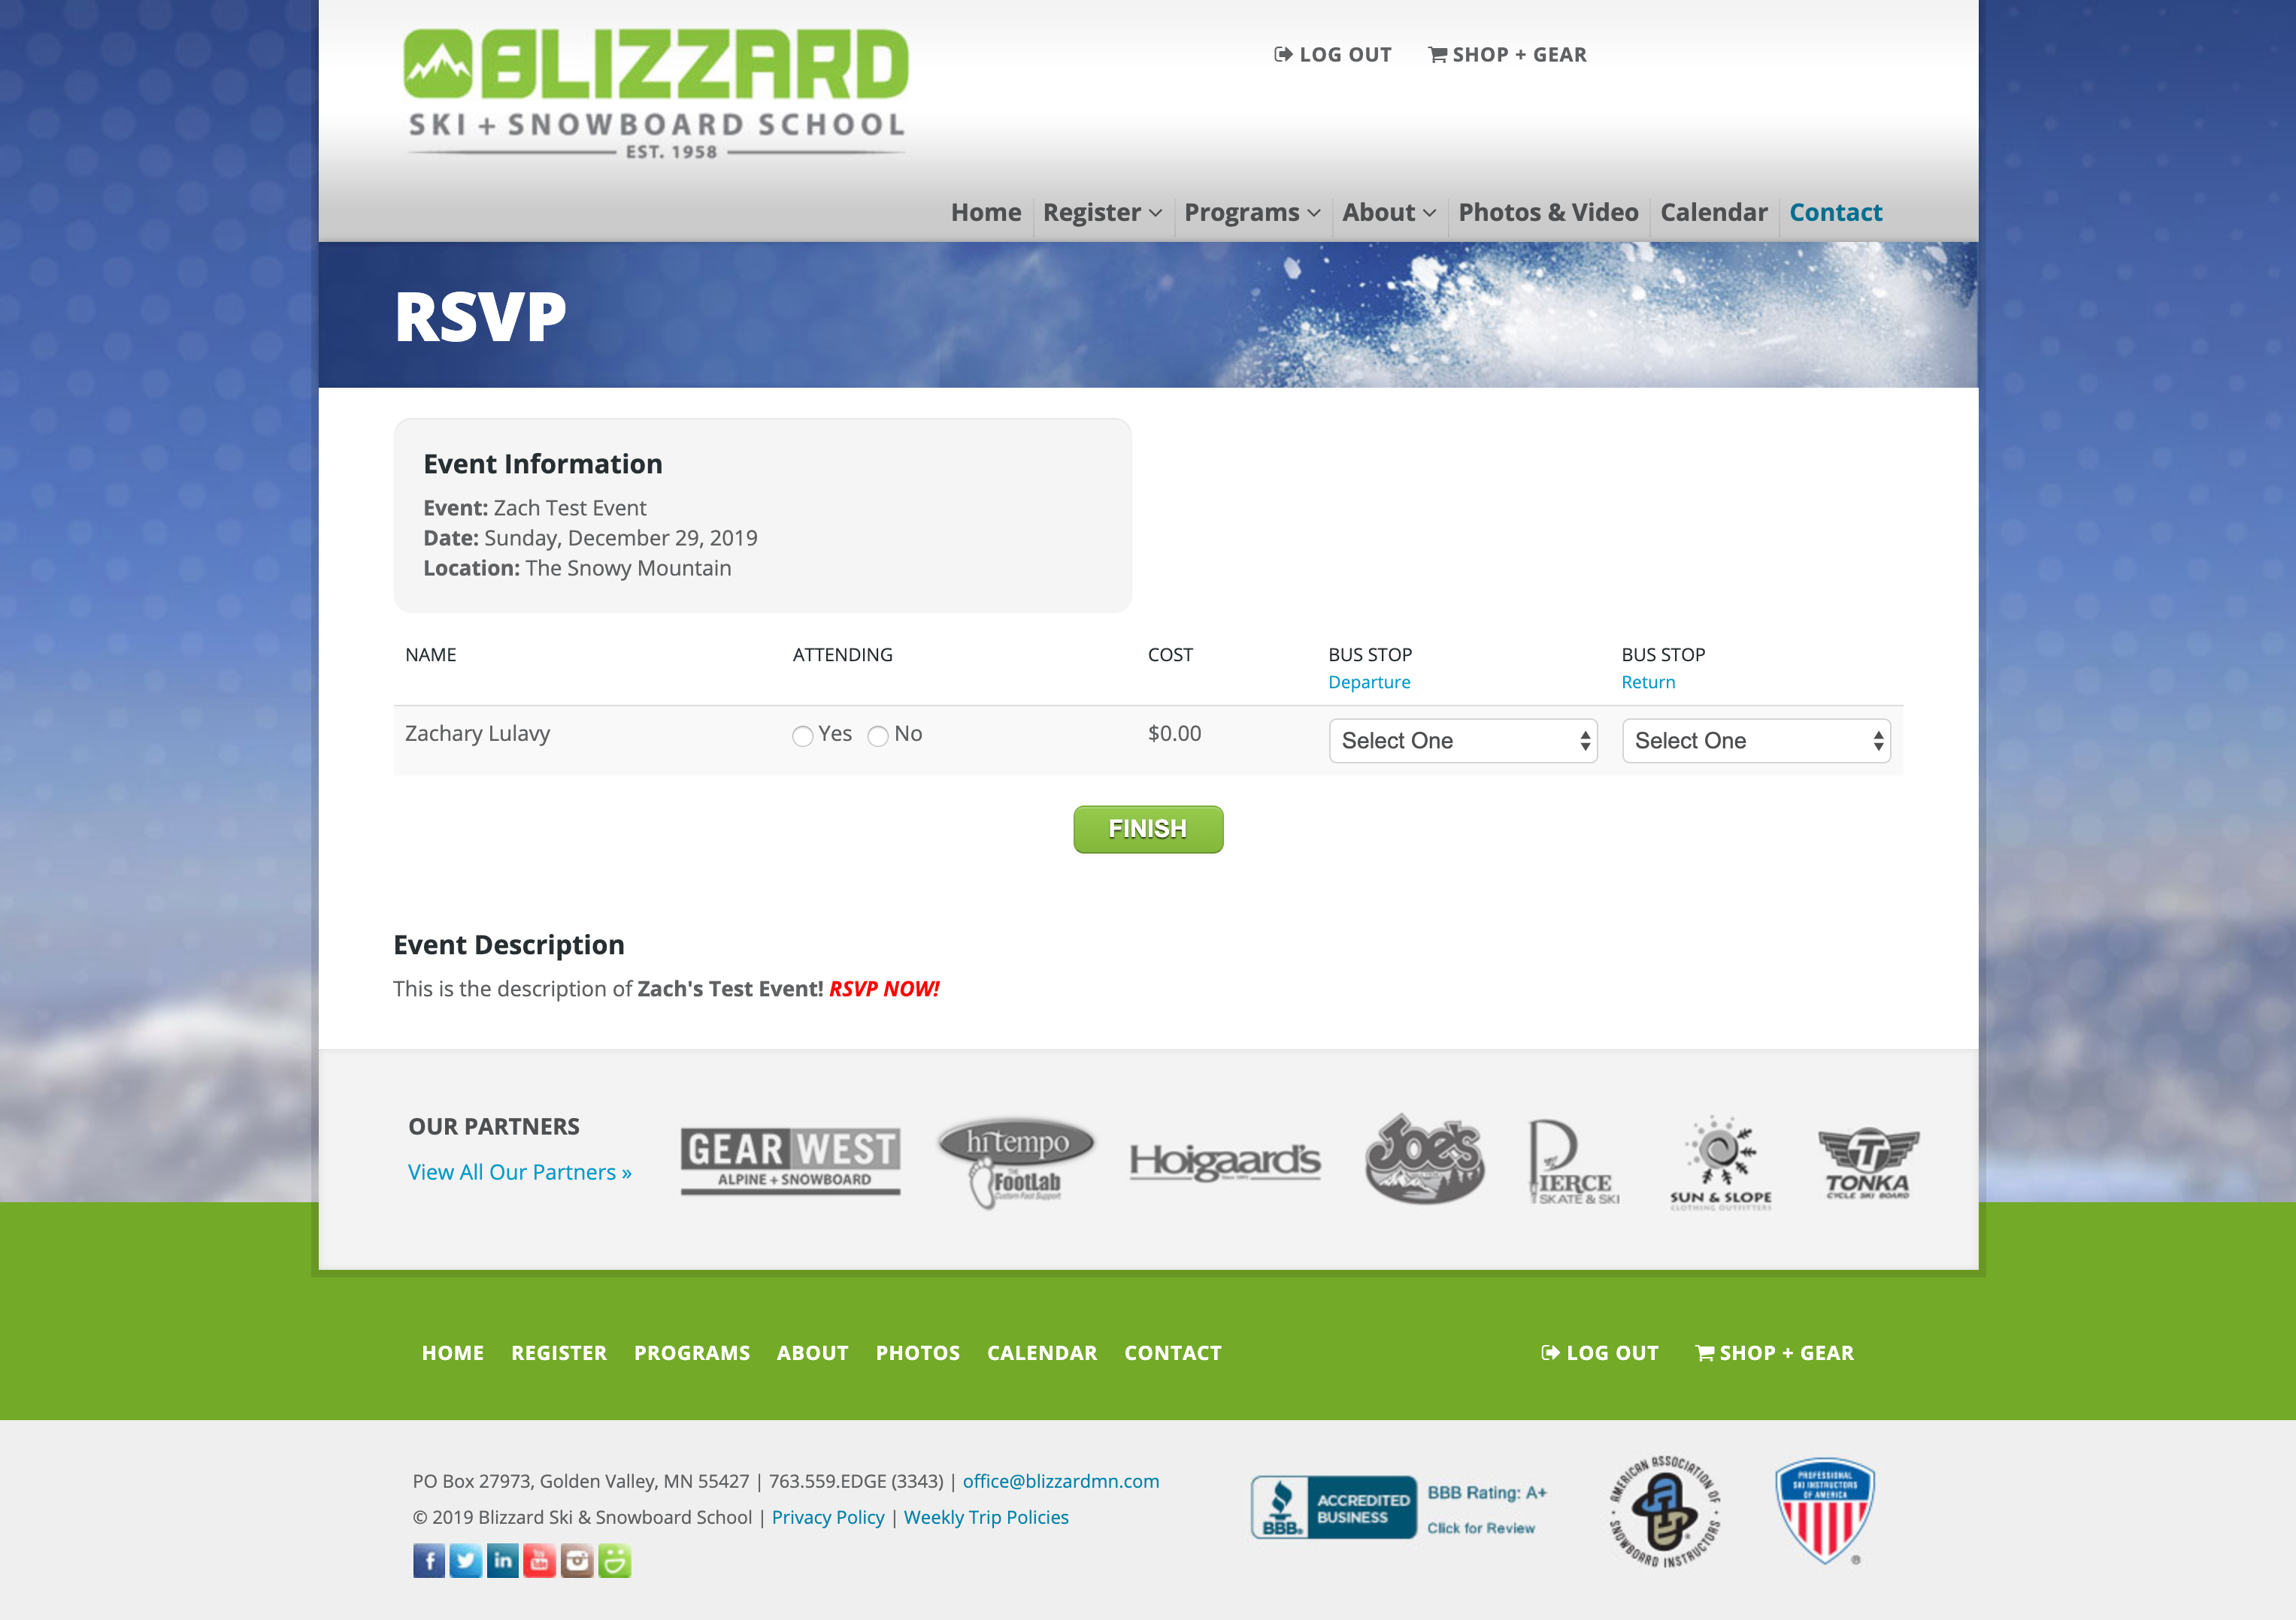
Responding to rsvp
RSVP form is surprisingly simple and quick to fill out.
With only 3 spots to fill in
Issue must be in email

Slide 11
Cognitive Walkthrough data

Slide 12
Findings/reccomendations RSVP:
Enhance hierarchy of information
RSVP follow up reminders
Create microcopy strategy
Content and communication strategy
Add to calendar= not all day event, but automatically add bus times vs adding bus times in description
Users aren’t not responding because form is hard to fill, but because email isn’t being sent at the right time,
Course of action:
Research microcopy strategy
Prototype revised rsvp system
give a phase 2 and phase 3 plan. This is phase 1, it will get to down to a 8% no response rate, here are the next steps that are needed to bring that number down further

Slide 13
Staff Portal

Slide 14
Staff portal
What is staff portal, what’s it used for

Slide 15
Users and tasks
Tasks:
Look for RSVPs
Look for event dates
Look for clinic info
Certification info

Slide 16
Heuristics Tested
Staff Task | Heuristic Violated | Severity
Look for event dates
Look for clinic info
Certification info
Look for RSVPs
Severity
1
2
3

Slide 17
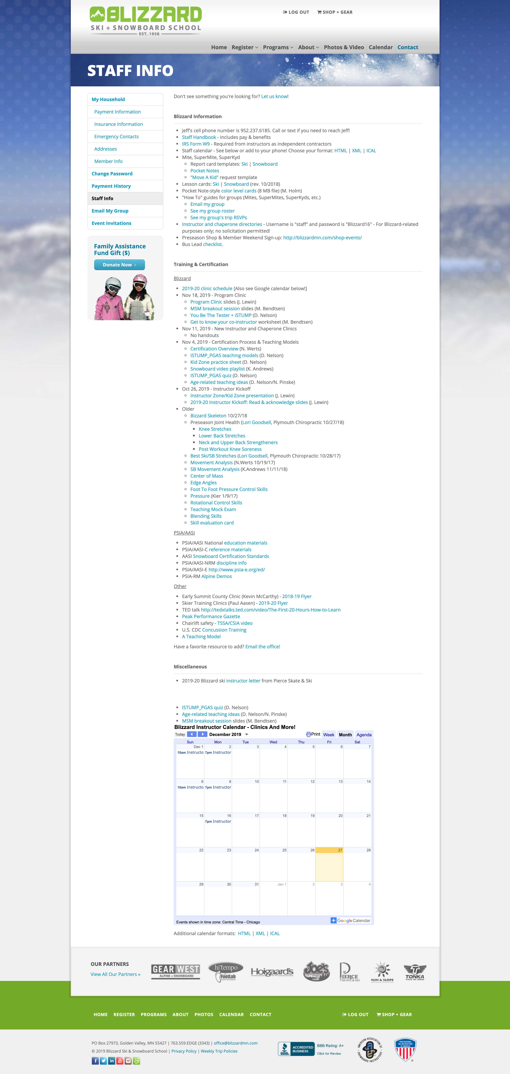
Heuristic
Nielson’s Heuristics
Visibility of system status The system should always keep users informed about what is going on, through appropriate feedback within reasonable time.
Match between system and the real world The system should speak the users' language, with words, phrases and concepts familiar to the user, rather than system-oriented terms. Follow real-world conventions, making information appear in a natural and logical order.
User control and freedom Users often choose system functions by mistake and will need a clearly marked "emergency exit" to leave the unwanted state without having to go through an extended dialogue. Support undo and redo.
Consistency and standards Users should not have to wonder whether different words, situations, or actions mean the same thing. Follow platform conventions.
Error prevention Even better than good error messages is a careful design which prevents a problem from occurring in the first place.
Recognition rather than recall Make objects, actions, and options visible. The user should not have to remember information from one part of the dialogue to another. Instructions for use of the system should be visible or easily retrievable whenever appropriate.
Flexibility and efficiency of use Accelerators -- unseen by the novice user -- may often speed up the interaction for the expert user such that the system can cater to both inexperienced and experienced users. Allow users to tailor frequent actions.
Aesthetic and minimalist design Dialogues should not contain information which is irrelevant or rarely needed. Every extra unit of information in a dialogue competes with the relevant units of information and diminishes their relative visibility.
Help users recognize, diagnose, and recover from errors Error messages should be expressed in plain language (no codes), precisely indicate the problem, and constructively suggest a solution.
Help and documentation Even though it is better if the system can be used without documentation, it may be necessary to provide help and documentation. Any such information should be easy to search, focused on the user's task, list concrete steps to be carried out, and not be too large.
Nielson’s Heuristics
Heuristics violated: 6, 7 (pop up windows vs. same screen), 8

Slide 18
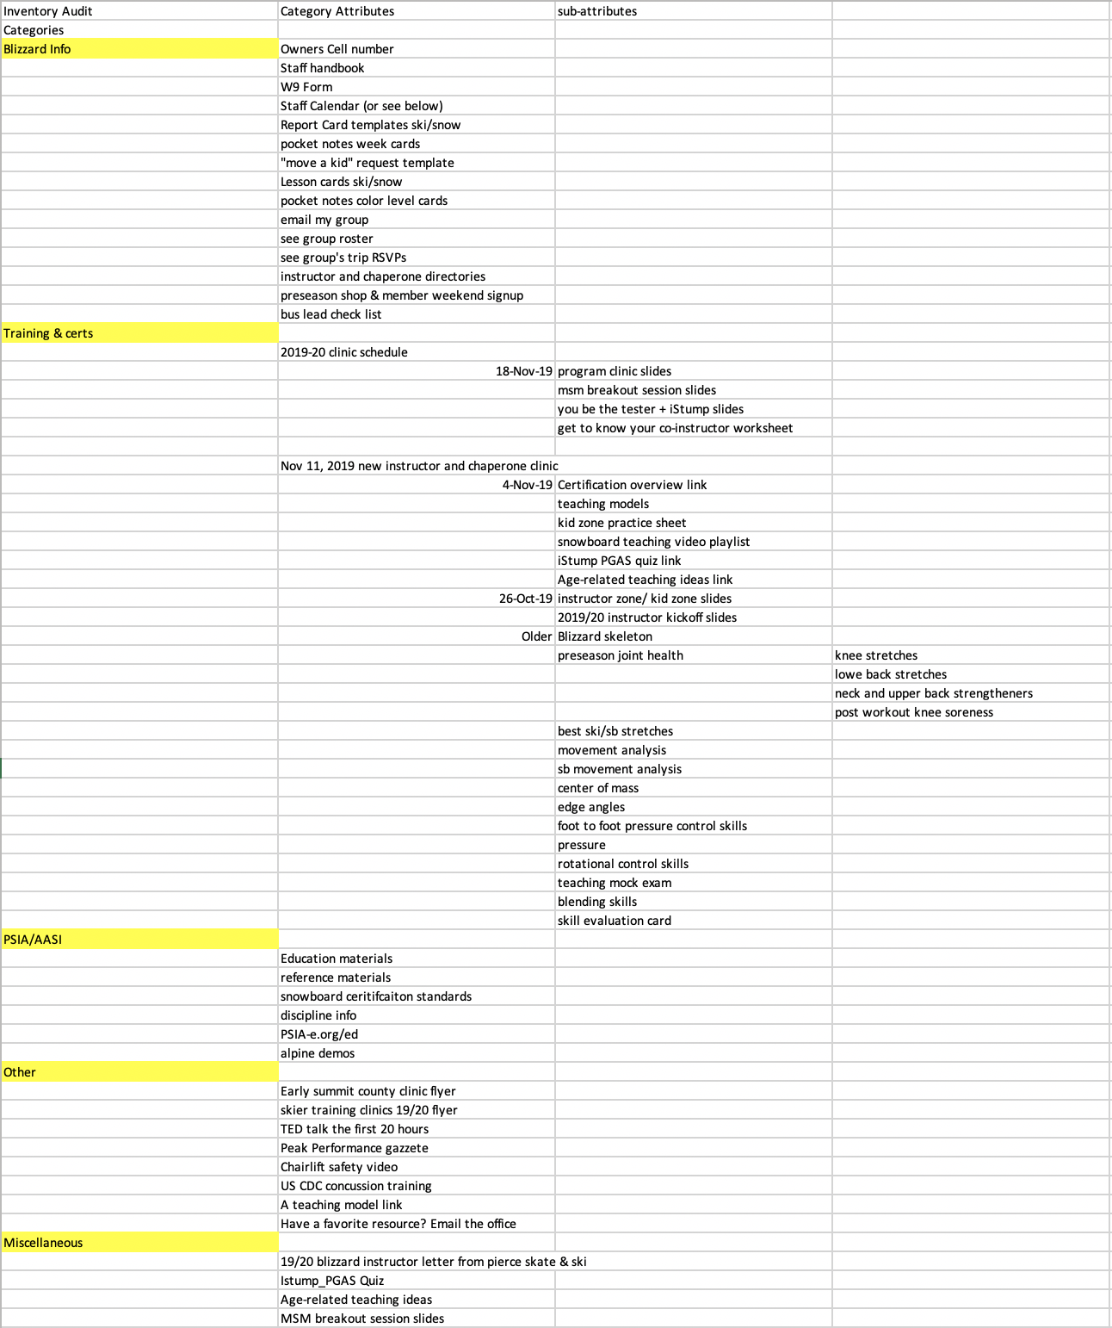
Inventory Audit
Recommendations:
Reorganization of pages
Renaming of categories
Issues:
Multiples of some pages

Slide 19
Findings/ action plan (Portal):
Multiple copies of articles
New headers
Discover content page conventions
Low fi prototypes of all pages including form fields
High fi prototype of most pages

